Slide 1
FUNDAMENTAL STUDY

Slide 2
FUNDAMENTAL STUDY to INNOVATION APPLICATION TECHNOLOGIES

Slide 3
Prof. Dr. Valeri Saveliev –
Russian Physicist and Mathematician,
expert in the physics, mathematical modeling, data analysis, high performance computing systems.
Institute of Applied Mathematics, Russian Academy of Sciences, Moscow, Russia,
Lomonosov State University, Moscow, Russia,
Immanuil Kant Baltic Federal University, Kaliningrad, Russia,
Huazhong University of Science and Technology, Wuhan, China

Slide 4
Education
Graduated of the National Research Nuclear University, former Moscow Physics and Engineering Institute, 1974
PhD scientific degree (Candidate of Sciences) in National Research Nuclear University, former Moscow Physics and Engineering Institute, 1978
Dr. Dr. (Doctor of Physics and Mathematics Sciences – highest scientific degree in Russia) National Research Nuclear University, former Moscow Physics and Engineering Institute, 2002

Slide 5
Academic Achievements
Professor of the National Research Nuclear University (Moscow Physics and Engineering Institute);
Invited Professor of Paris University VI, Paris, France;
Professor of the Maryland University, USA;
Professor of Immanuel Kant Federal Baltic University, Kaliningrad, Russia;
Professor of Huazhong University of Science and Technology, Wuhan, China;

Slide 6
Publication Activity
More than 500 publications in Reference Scientific Journals
Web of Sciences: 292 publications, H-index 39
3 Monographs: Monograph Chapter: open access has more than 5000 downloads
8 patents: 3 US patents 2009-2012;
More then 30 invited and oral talks on the most famous International Conferences (number of Participants > 500) : IEEE, NDIP, SPIE and others

Slide 7
Fundamental Study

Slide 8
Experience in World Wide International Collaborations
International Experiment Atlas, CERN, Swiss;
International Experiment “HERA-B, DESY, Hamburg, Germany;
International Experiment “OPERA”, CERN-Gran Sasso, Italy;
International Experiment “CDF”, National Fermi Accelerator Laboratory, Chicago, USA
International World Wide Experiment “ILC- International Linear Collider”, more than 120 Institutes and Universities around the World;

Slide 9
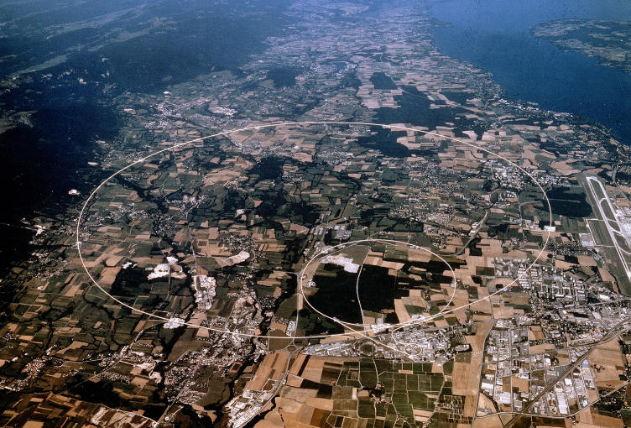
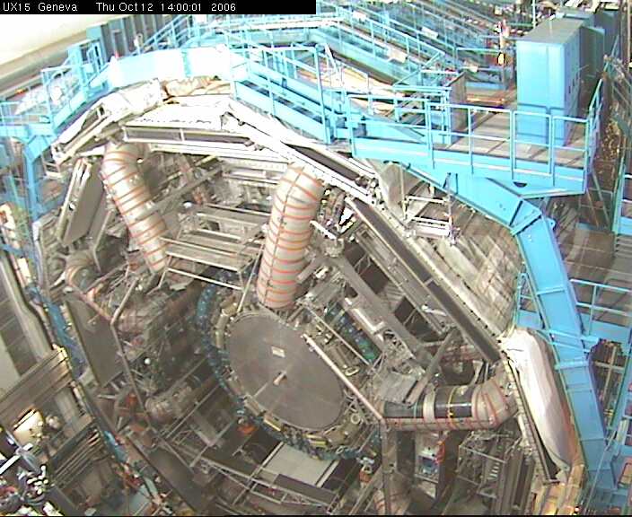
Fundamental High Energy Physics
Since 1992 - European Center of Nuclear Research, experiment Atlas, Theory of the Transition Radiation, development of the Transition Radiation Detector.

Slide 10
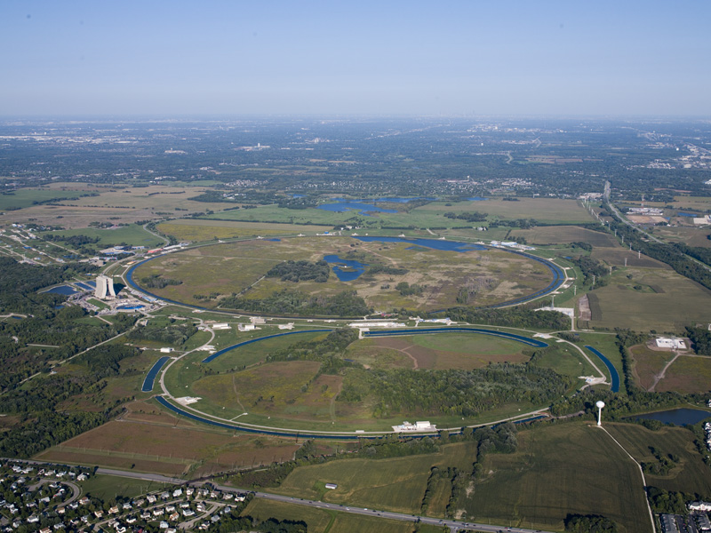
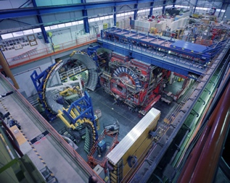
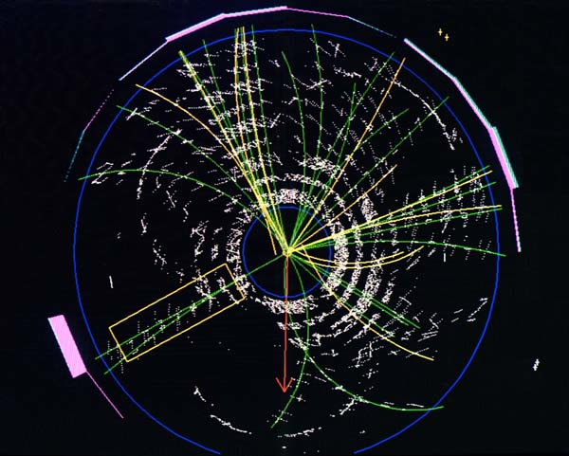
Fundamental High Energy Physics
International Experiment “CDF”, National Fermi Accelerator Laboratory, IL, Chicago
Since 2000 Study of CP-Violation Processes, Mathematical modeling and analysis of experimental data…

Slide 11
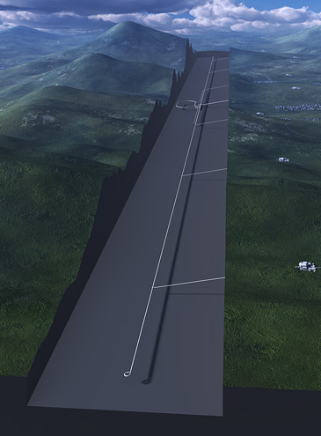
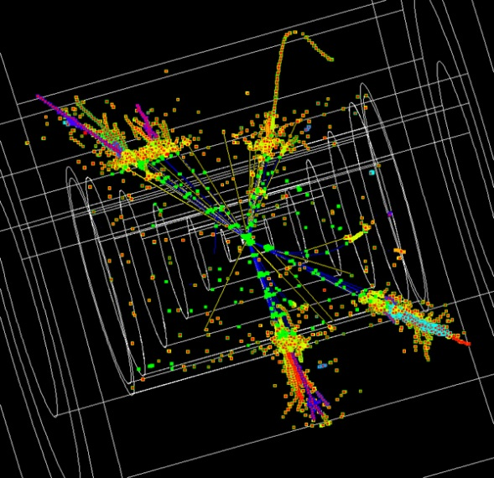
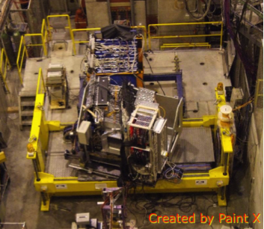
Fundamental High Energy Physics (Future)
Since 2000 International Linear Collider, future World Wide Experiment
Higgs Boson Investigation, Extra Dimensions

Slide 12
Results of Fundamental Study
are Basis for the Innovation Applications

Slide 13
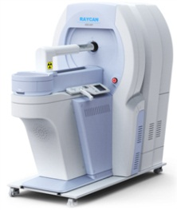
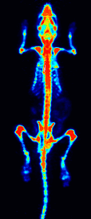
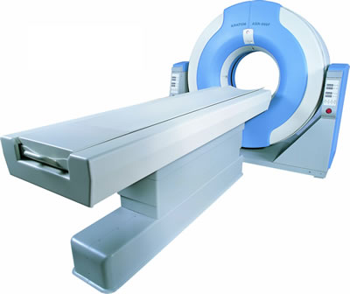
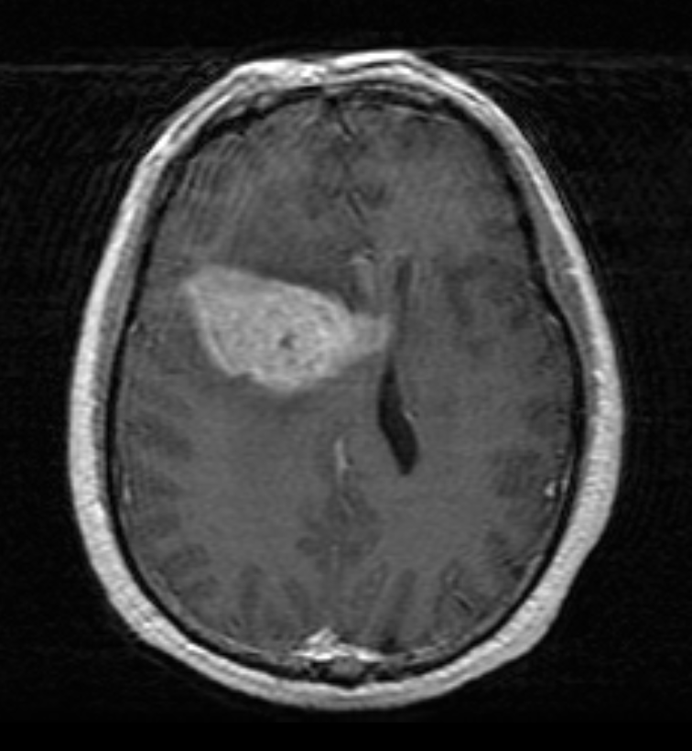
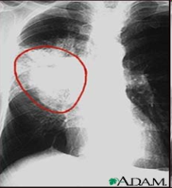
Medical Visual Diagnostics System
Positron Emission Tomography (PET) is one of the most efficient Cancer Functional Diagnostics
Functional
MRT
(2003 Nobel Prize)
PET
CT
(1979 Nobel Prize)
Topological
X-ray
(1901 Nobel Prize)
Since 2012 development of the New Generation
of PET, in China

Slide 14
Medical Visual Diagnostic System - PET
Functional Diagnostic: PET
PET Principle
Novel Technology gives the Significant Improvement in Effective Diagnostic
of Most dangerous Disease - Oncology

Slide 15
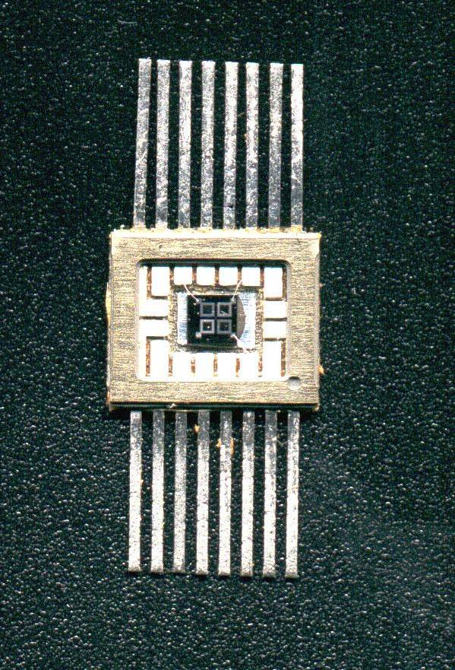
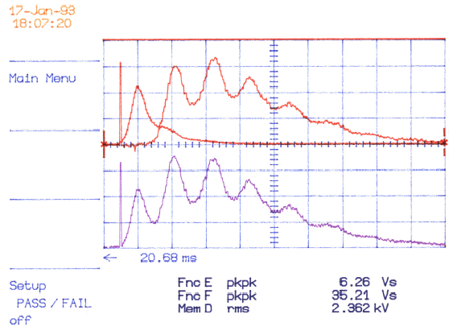
Novel Detection Technology
Silicon Photomultiplier for the Extremely Low Photon Flux Detection
First Silicon Photomultiplier
(Metal Resistor Semiconductor Structures)
First Evidence of the Single Photon Detection Capability
Modern Technology is basis for the Novel Medical Visual Diagnostic System

Slide 16
China is Great Opportunity for Progress
2015 - 100 Talents Program for China, Hubei Province;
2016 – 1000 Talent Program for China;
2017 – SAFEA Expert, the Foreign Expert Consultation Meeting;
2018 – National Friendship Award;

Slide 17
China Achievements:
Foreign Expert Consultation Meeting

Slide 18
Theory with Implementation in to Applications
is Way of make the Progress in the Most Important Areas of Human Life !

