Slide 1
GDCh – German Chemical Society
Opportunities and Challenges for Young People and Enterprises amid the Trend of Reform and Innovation
Parallel Session 3
"Growth of Young Scientists and SMEs"
October 16, 2019, Beijing/China
Dr. Hans-Georg Weinig ● Director Education, Career and Science

Slide 2
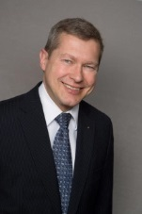
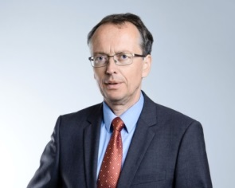
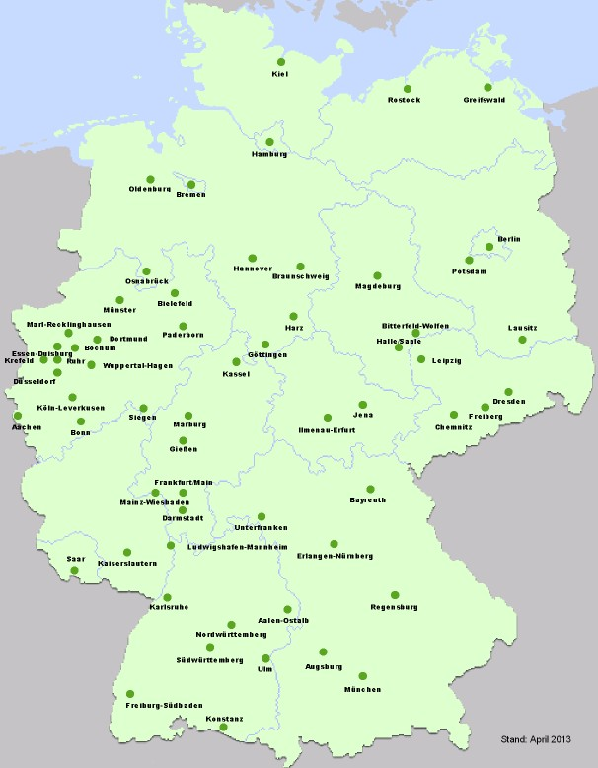
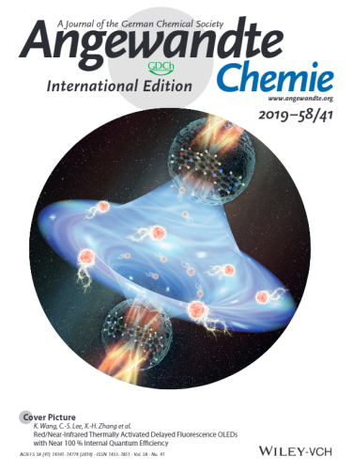
GDCh – Facts & Figures
Prof. Dr. Wolfram Koch
Executive Director
Dr. Matthias Urmann
GDCh President 2018/19
ca. 31.000 Members
27 Divisions
60 GDCh Local Sections
Young Chemists Forum
54 Local Sections
11 Foundations
> 20 GDCh Awards
> 1.000 Grants/Year
Journals
GDCh
Head Office
Frankfurt am Main
www.gdch.de

Slide 3
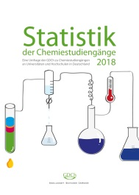
GDCh – Career Service/Statistics
PhDs in Germany: ●Germans ●Foreigners
Chemical/Pharmaceutical Industry in Germany
Overall number of companies (2016) | ca. 2000
Small and Medium Enterprises (SMEs, <500 Employees) | > 90%
Number of Employees (2018) | 487.000
Number of Employees (2018) – EU 28 | 1.8 Mio.
Number of Employees (2018) – China | 12.4 Mio.
Source: VCI/Federal Office of Statistics
>50% Chemists are not working in the large Chemical Industry!
www.gdch.de/statistik

Slide 4
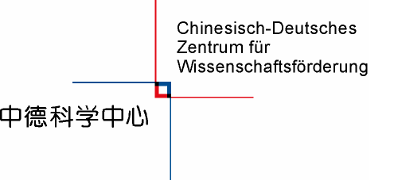
Career Opportunities
► Establish and strengthen your network continousely
► Join your chemical society/learned society as member
► Be open minded & talk to people
► Demand ethical behaviour from yourself & your employer
► Collaborate nationally & internationally
► Watch out the SME scene → thousands of potential employers out there
► Watch out the Start-up scene → agile inventors of the new „Working World 4.0“

Slide 5
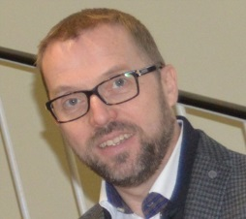
Thank you & Congratulations
Contact
Dr. Hans-Georg Weinig
Director Education, Career and Science
German Chemical Society (GDCh)
Varrentrappstr. 40-42
60486 Frankfurt am Main, Germany
Tel.: +49 69 7917-482
Fax: +49 69 7917-1482
E-Mail: h.weinig@gdch.de
www.gdch.de
Celebrations of the 70th anniversary of the founding of the People's Republic of China 庆祝中华人民共和国成立70周年活动
Source: https://en.wikipedia.org/wiki/70th_anniversary_of_the_People%27s_Republic_of_China

